Slide 1
Compact OPO service Training
1st & 2nd March 2017

Slide 2
Content
Introduction to COPO
Pump sources for COPO
Unpacking the COPO
COPO connections, Head and Panel PC
Software Interface
Customer Interface
Service Interface
Pre-Installation
COPO Alignment overview

Slide 3
Chameleon compact opo
Closed box / hands free PP-Fan-OPO
Reduced size due to folded cavity
Temperature stabilized / purged
2 operation modes: Ti:Sa pass through / 15% Ti:Sa + OPO
Computer controlled phase-matching / Signal-tuning / power optimization
OPTICAL PARAMETRIC OSCILLATOR

Slide 4
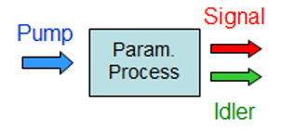
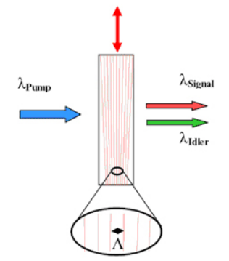
OPO operation
COPO is designed specifically to use the Chameleon as a pump source
Extends the WL coverage of the Chameleon into the near IR
Achieved by frequency conversion of the original WL into two longer WLS
λpump < λsignal < λidler
e.g 800nm pump < 1100nm signal < 2933nm idler
Fan-poled crystal – moves in vertical direction, different poling periods are available, allow phase-matching for a given combination of pump and signal wavelengths

Slide 5
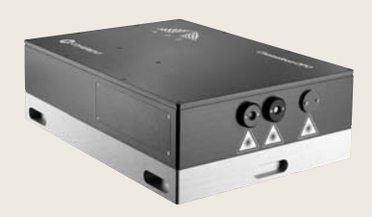
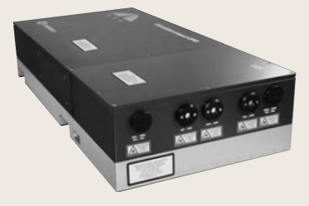
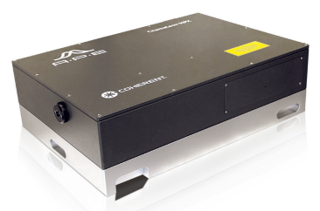
the COPO FAMILY
Standard Compact OPO
Max IR
Idler (option)
Chameleon-OPO-Data-Sheet
Compact OPO-Vis
Compact OPO Vis Output Options Intro
Chameleon-OPO-Vis-Data-Sheet
Chameleon MPX
Chameleon-MPX-Data-Sheet

Slide 6
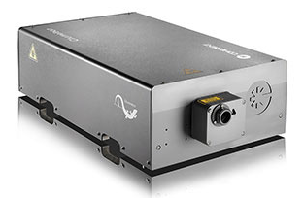
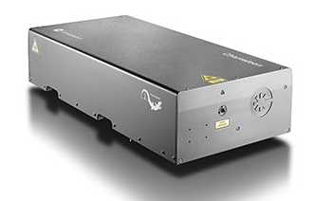
Pump sources for the Compact OPO
Chameleon Ultra 80MHz
Tuning range – 680nm to 1080nm
COPO pump range – 740nm to 880nm
Chameleon Vision 80MHz
Tuning range – 680nm to 1080nm
COPO pump range – 760nm to 880nm
*Systems not suitable for pumping Compact OPO
All Chameleon 90MHz systems - due to incompatibility of rep rate;
Vision-S

Slide 7
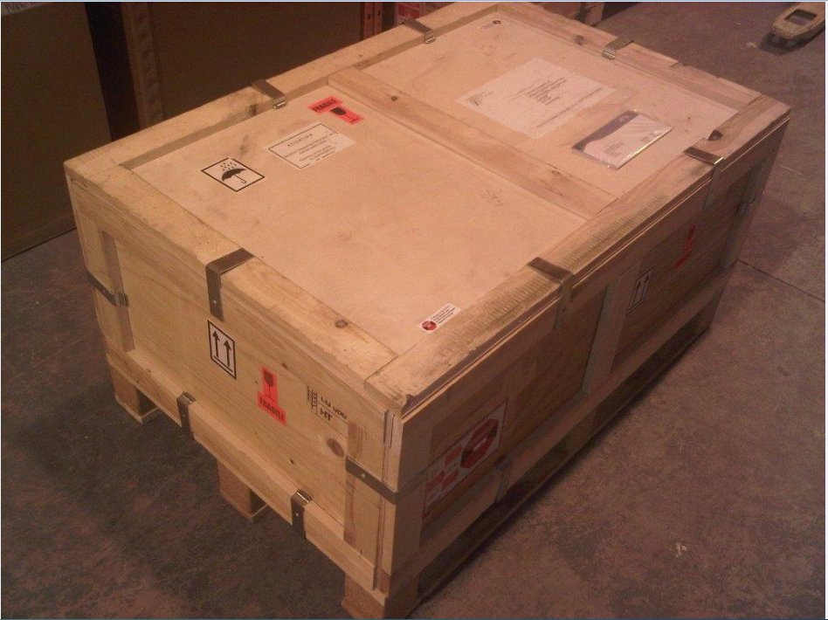
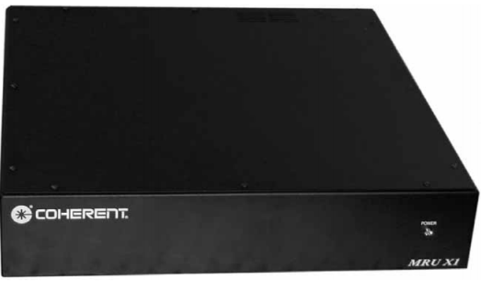
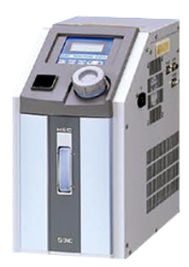
Unpacking the Compact opo
The Compact OPO will be shipped with three boxes
Compact OPO head, Panel PC & Accessories
MRU
Chiller
(*CoolFlow IGE)

Slide 8
Accessories
Cables
Mains cables
USB cable
RS-232 null modem cable (for connection with external PC)
Tools
Chiller hoses
Laser safety tube
Foot clamps (x3)
Fixing screws
Alignment apertures (x4)
Infrared sensor card
Gloves (x6)
Hair net (x2)
Hex keys for mirror adjustment (2mm & 2.5mm)

Slide 9
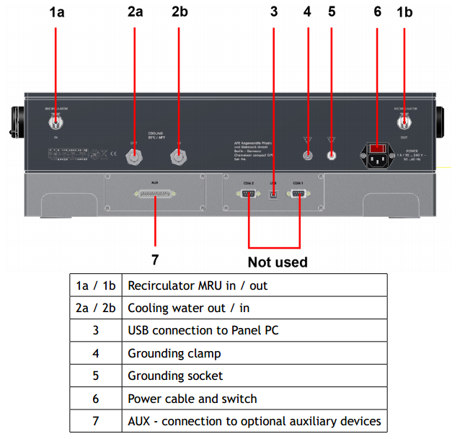
COPO connections

Slide 10
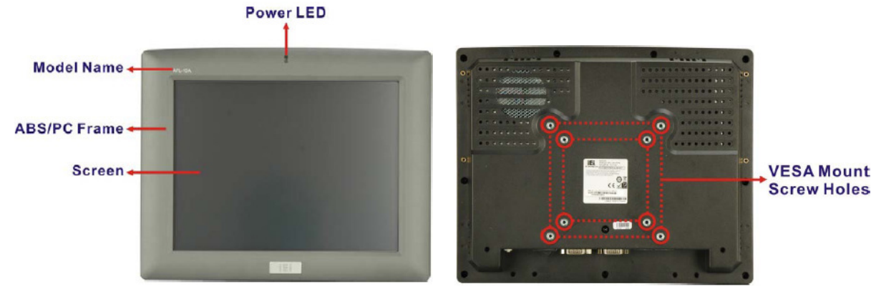
Panel pc

Slide 11
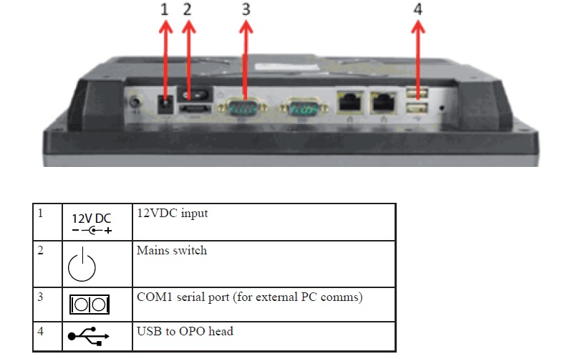
Connections to Panel pc

Slide 12
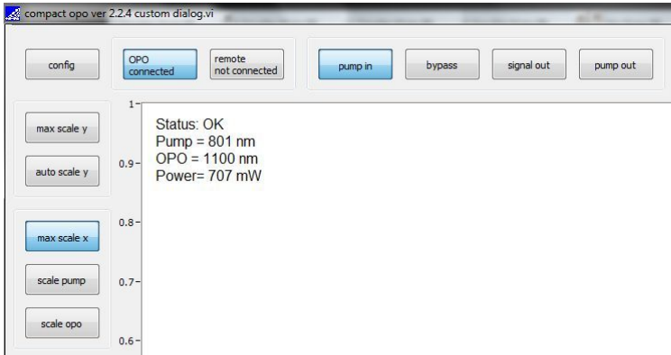
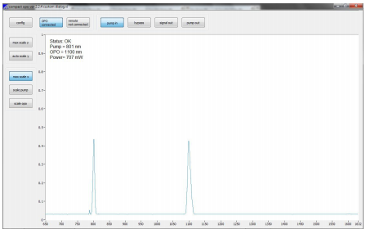
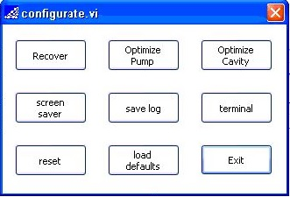
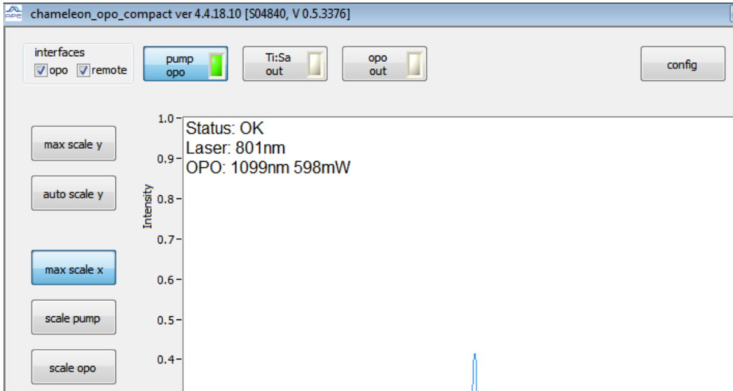
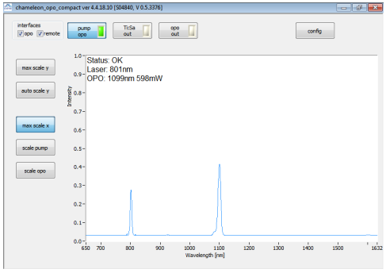
Software interface - user mode
Old SW
Current SW

Slide 13
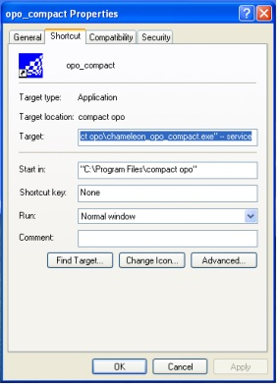
Service access (old S/W)
Service Interface
Service manual section 7.0
To enter service mode you need to change the target line. At the end of the line add;
space -- space service ( -- service)

Slide 14
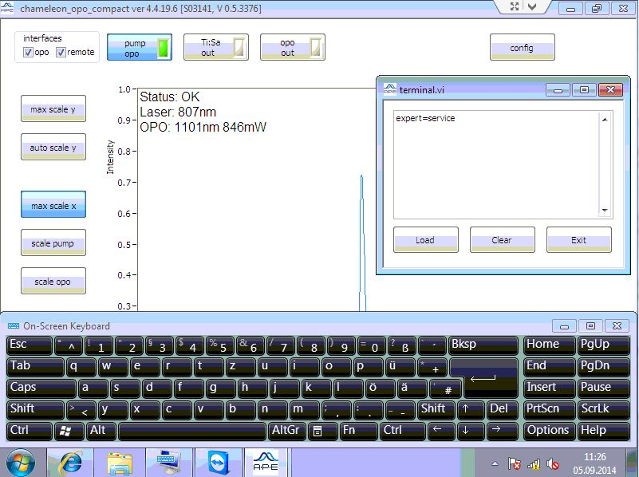
Service access (current S/W)
To enter service mode select ‘config’ tab, then type ‘expert=service’.
To exit service mode type ‘expert=0’.

Slide 15
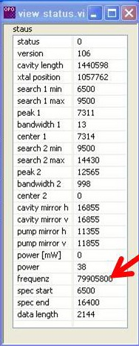
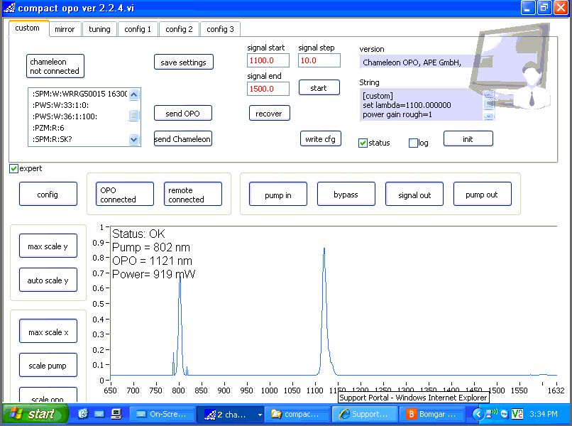
Custom tab

Slide 16
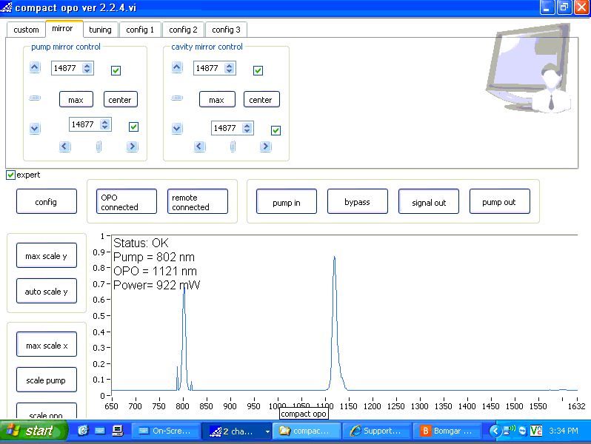
Mirror tab
Starting Position for Mirrors is always centered

Slide 17
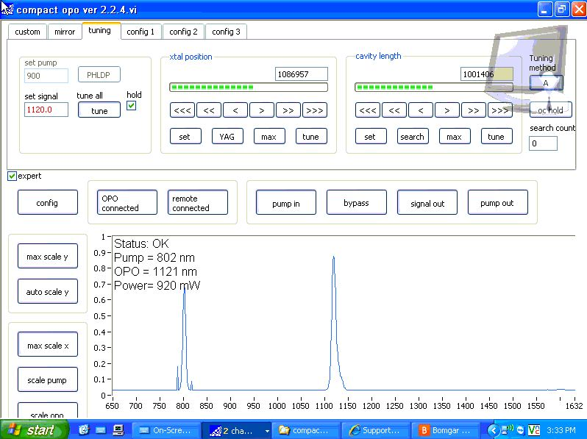
Tuning tab

Slide 18
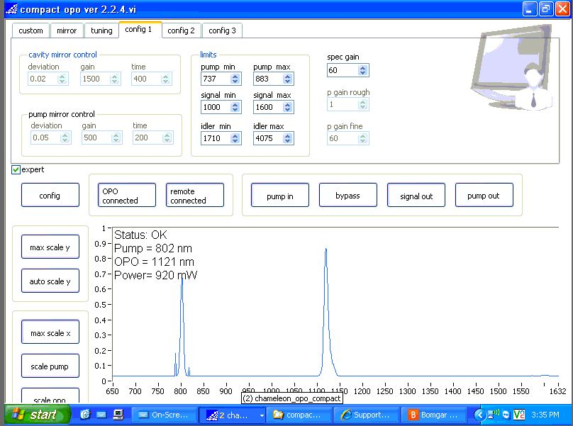
Config 1 tab

Slide 19
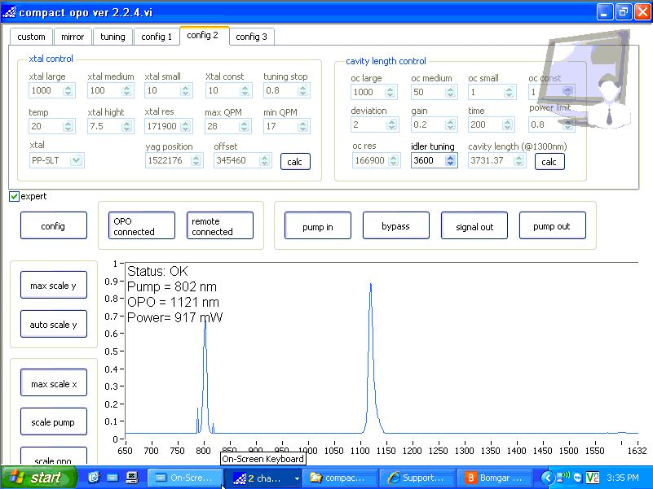
Config 2 tab

Slide 20
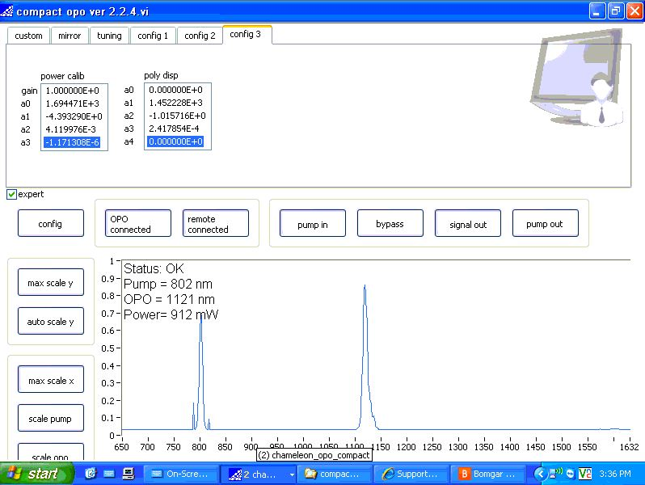
Config 3 tab

Slide 21
Pre-Installation
Chameleon laser must be installed as per standard service procedures
In particular CW and QS pump powers must have been calibrated using a Rees or Wavescan spectrometer
The laser must be thermally stabilised
The pump laser and OPO should be configured in-line and no intermediate steering optics
Recommended distance between laser and OPO is 60-150mm
Service engineer should carry a USB mouse

Slide 22
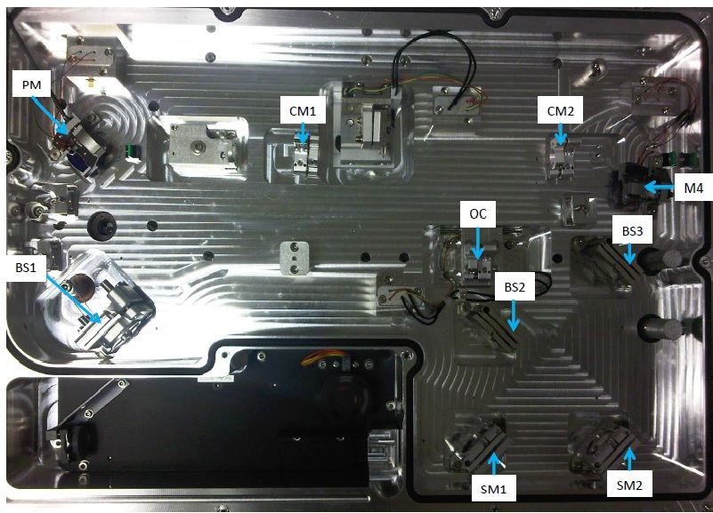
COPO cavity

Slide 23
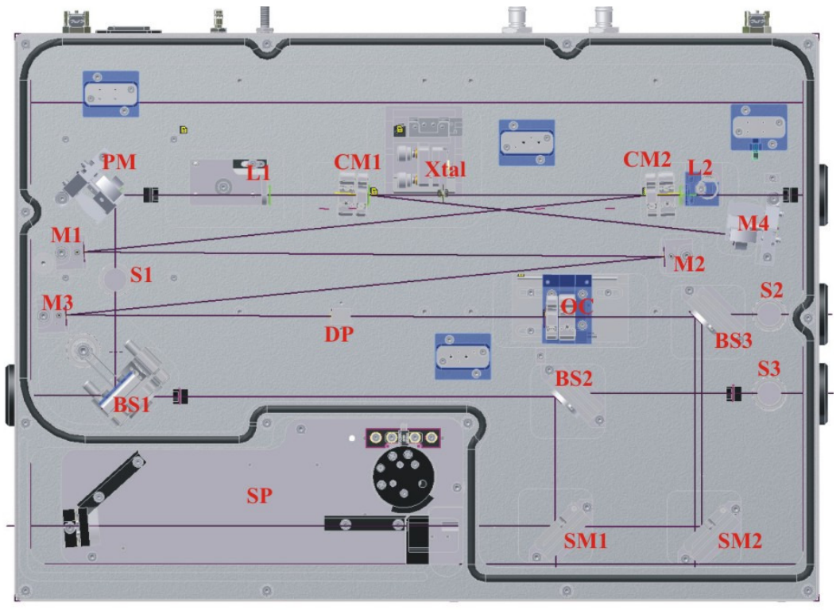
Cavity
3 Sensor Elements
Active Tuning Elements
Spectrometer
Fast PD
Slow PD

Slide 24
Alignment *Note this is a Brief overview only
OPO Head Alignment Alignment mode
Spectrometer & Fast PD Alignment 800nm
Pump In Alignment Alignment mode
Cavity Alignment 1st Pass 800nm
Cavity Alignment 2nd Pass 800nm
Start OPO Adjust cavity length to start OPO generation
Optimisation of power and tuning

Slide 25
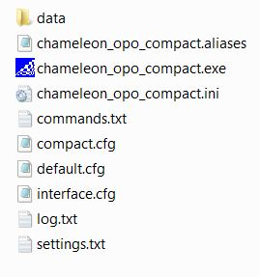
Locate the settings file
Old SW – C:\Program Files\opo compact
New SW – C:\ProgramData\APE\compact opo

Slide 26
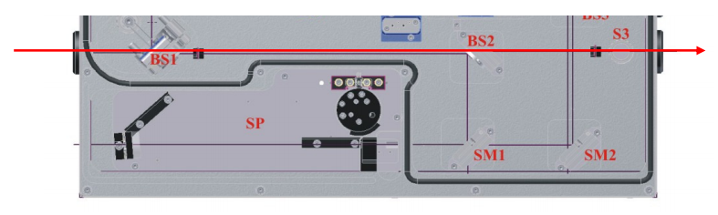
OPO head alignment
Set the Chameleon to Alignment mode
Place one of the slit aperture in front of BS1 and the other one before S3
Align the OPO on the table so that the beam passes through both apertures
Clamp the OPO onto the table to avoid shifting the OPO during the alignment process

Slide 27
Spectrometer & Fast pd Alignment
Block the pump-in beam path into the OPO cavity
Tune the Chameleon to 800nm
Maximise the spectrometer peak at 800nm using BS2 and SM1

Slide 28
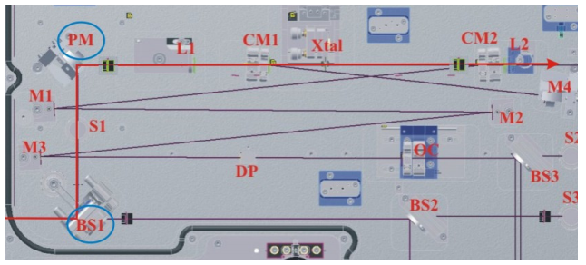
Pump In Alignment
Set the Chameleon to Alignment mode
Place one of the hole apertures in front on PM and the other one before CM2
Use BS1 and PM to align the beam onto both apertures

Slide 29
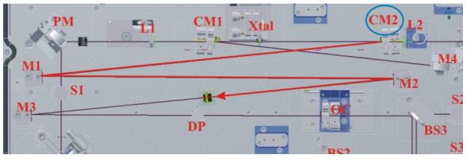
Cavity Alignment 1st Pass
Tune the Chameleon to 800nm
Place one of the hole apertures in the centre of the cavity (between M2 and M3)
Using CM2 only, centre the bright spot on the alignment hole

Slide 30
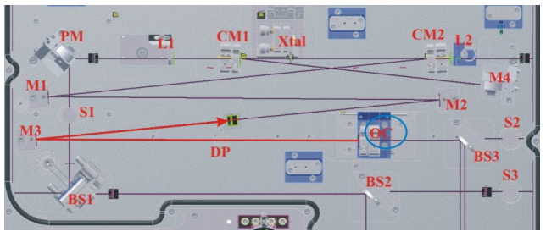
Cavity Alignment 1st Pass con’t
Use the OC to adjust the back reflection on the other side of the hole aperture

Slide 31
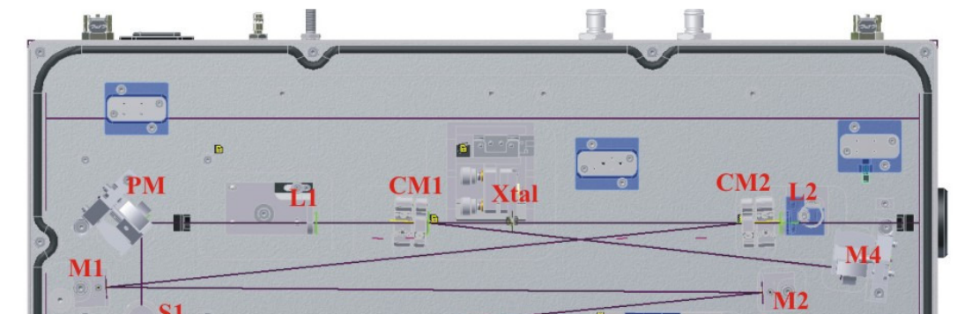
Cavity Alignment 2nd Pass
Place the hole aperture in front of M4
Centre the spot on the front side of the aperture using CM1
Adjust the back side reflection using M4

Slide 32
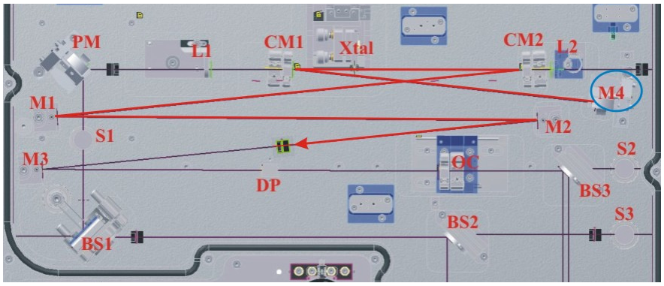
Cavity alignment 2nd pass con’t
Place the hole apertures back into the centre of the cavity (between M2 and M3)
Re-adjust the back reflection using M4

Slide 33
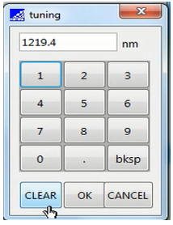
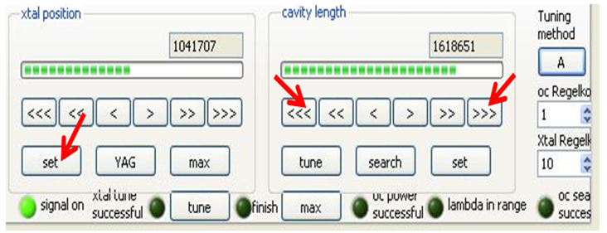
Start OPO
Once alignment has been optimised, remove alignment aperture
Select a wavelength e.g. 1100nm
Select the tuning tab and press ‘SET’ on the crystal position
Move the output coupler (cavity length) until a bright flash is seen
Fine tune the OPO generation using the cavity length adjustments

Slide 34
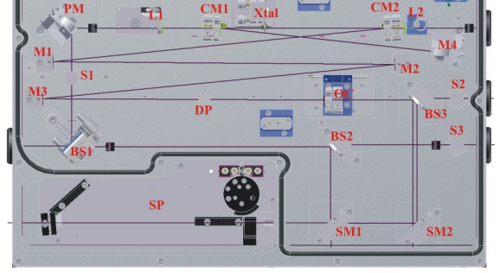
Optimisation of power and tuning
PM
Adjust BS3 and SM2 to maximise the signal peak on the spectrometer
Place an external power meter at the OPO signal output
Adjust M4 and OC iteratively to optimise the signal power
Perform data collection

Slide 35
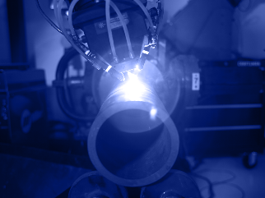

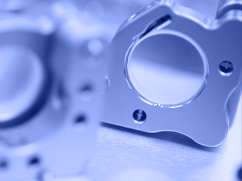
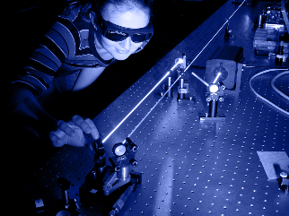
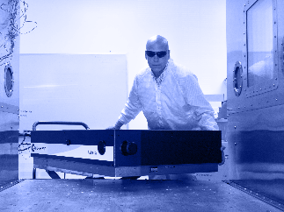
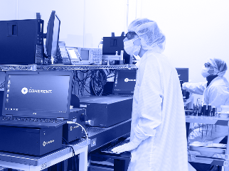
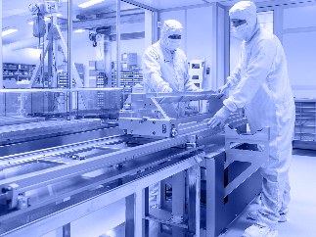
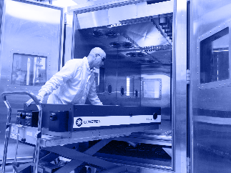

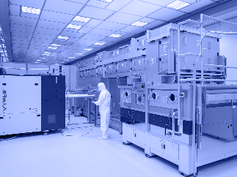
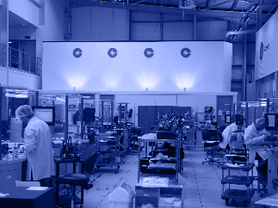

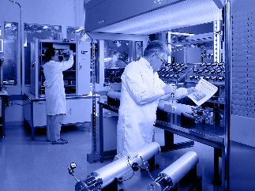
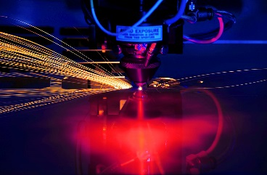



Approved sample images

